Slide 1


AtliQ Hardware Ad-hoc Analysis

Slide 2
Problem Statement
Atliq Hardware is a hardware retail business that operates in multiple markets and offers a wide range of personal computers, mice, printers, and various other peripherals.
The business faces the challenge of analyzing large volumes of sales data across different branches and regions to gain actionable insights for decision-making. Currently, the business lacks a comprehensive data analysis solution to evaluate its financial performance and optimize its sales strategy.
The objective of this project is to leverage SQL to analyze Atliq Hardware's sales data and generate key business insights that will help the management team make data-driven decisions.

Slide 3
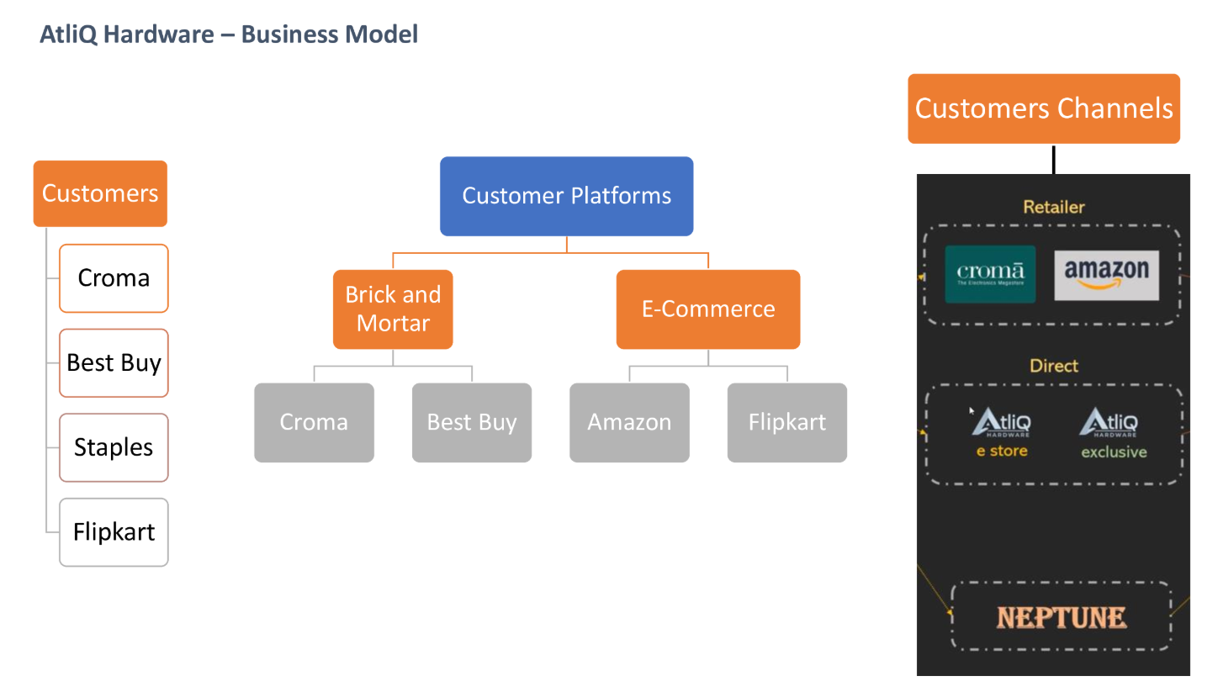
AtliQ Hardware - Business Model

Slide 4
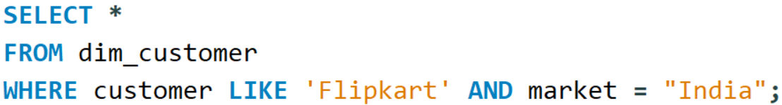
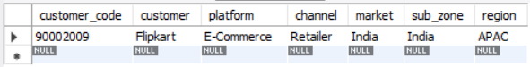
Retrieve the Customer Code for customer “Flipkart” operating in Indian Market.
OBJECTIVES

Slide 5
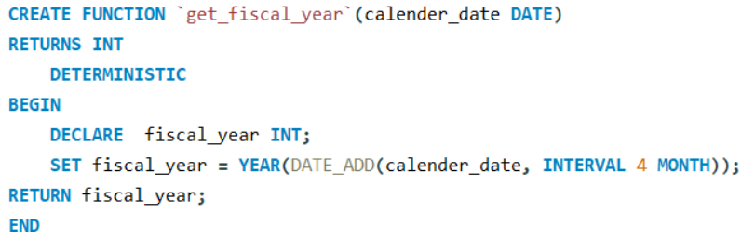
USER DEFINED FUNCTIONS
Create a user-defined function `get_fiscal_year` to get corresponding fiscal year by passing the calendar date.

Slide 6
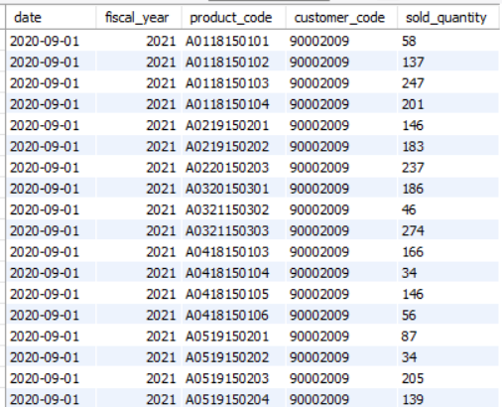
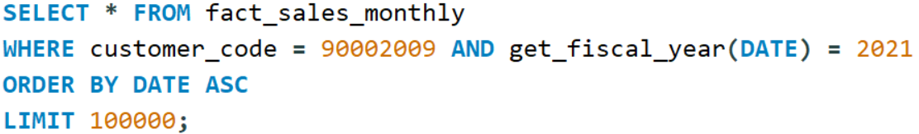
Retrieve all sales transaction for customer “Flipkart” for the Fiscal year 2021.

Slide 7
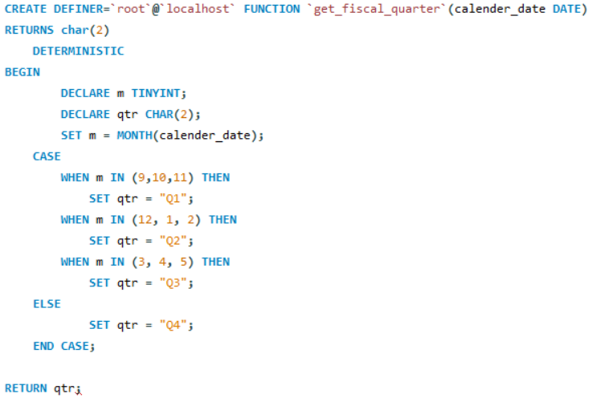
Create a user-defined function `get_fiscal_quarter` to get Quarterly sales transactions for customer

Slide 8
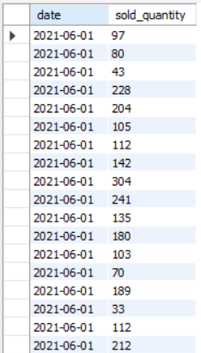
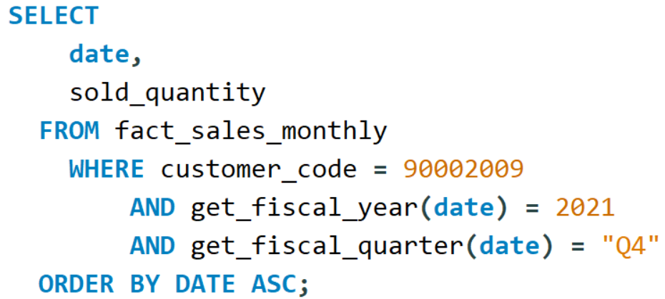
Using this function retrieved the sold_quantity for Flipkart for fiscal year 2021 in Quarter-4

Slide 9
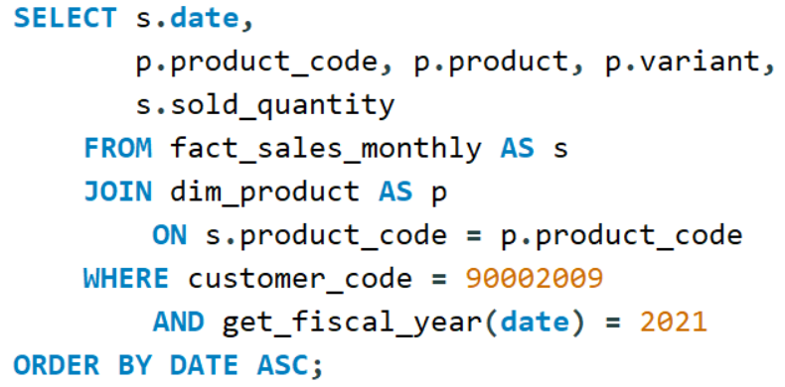
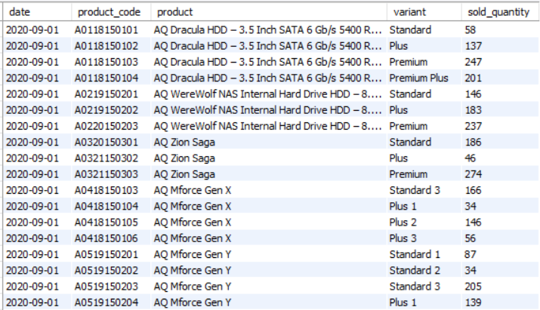
JOINS
Gross Monthly sales report:
Monthly sales transaction data for Flipkart
by Joining two Tables

Slide 10
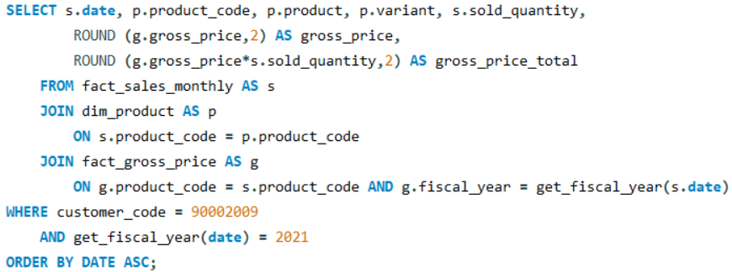
Gross Monthly sales report: Retrieve Gross_price and Gross_price_total by joining another table.
OUTPUT

Slide 11
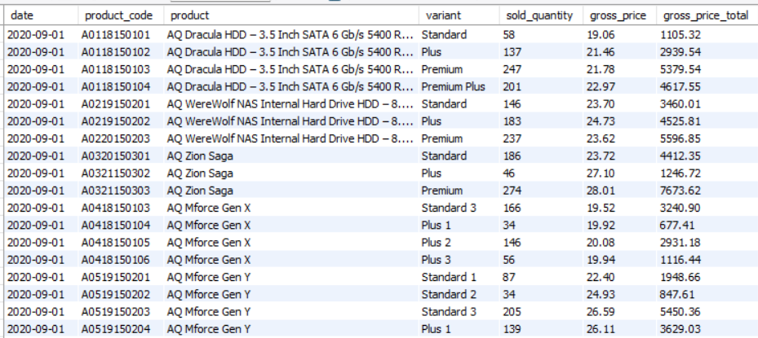

Slide 12
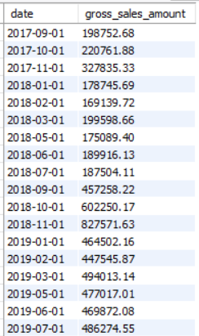
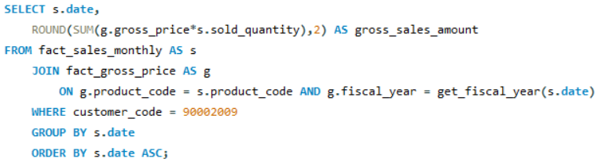
Retrieve Monthly Gross_sales_amount for Flipkart

Slide 13
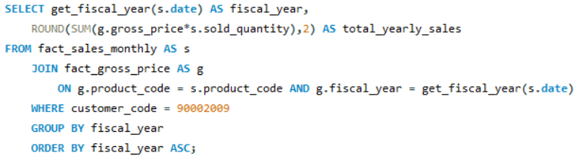
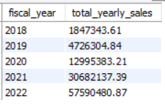
Generate Yearly sales report for customer

Slide 14
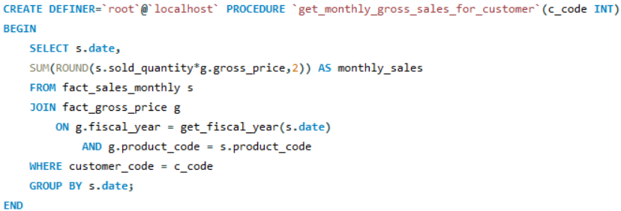
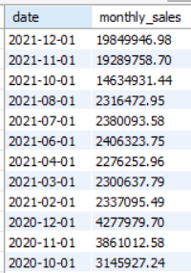
Create a Stored procedure to get monthly gross sales report for any customer passing any customer code into stored procedure.
STORED PROCEDURE

Slide 15
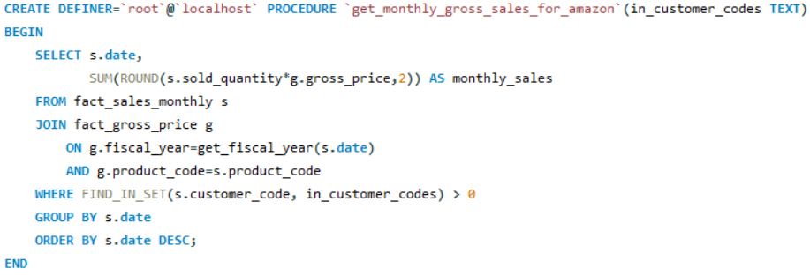
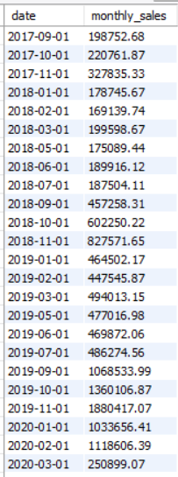
Sometimes customer has two or more codes, so create stored procedure to get monthly gross sales report for customer passing customer codes into list fromat in stored procedure.

Slide 16
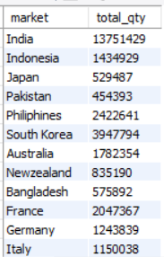
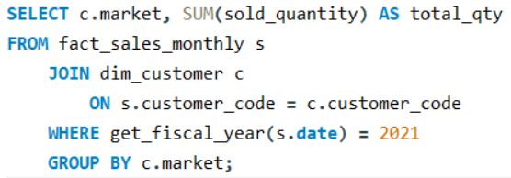
Create a Join between two tables to get Market wise sold quantities.

Slide 17
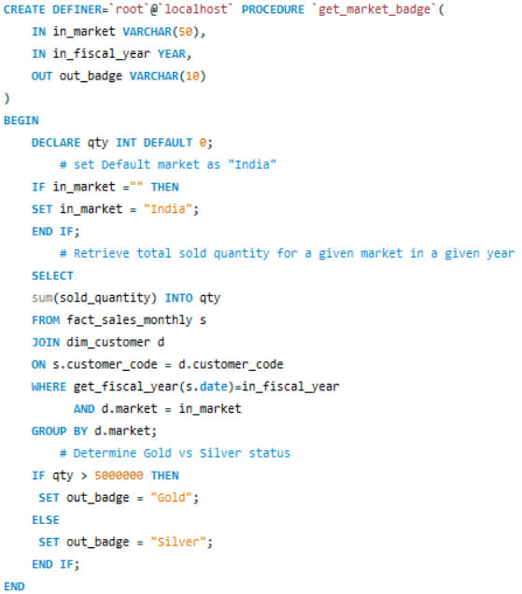
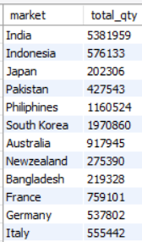
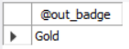
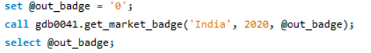
Create a Stored procedure to categorized market in three level
badge based on their sold_quantity.

Slide 18
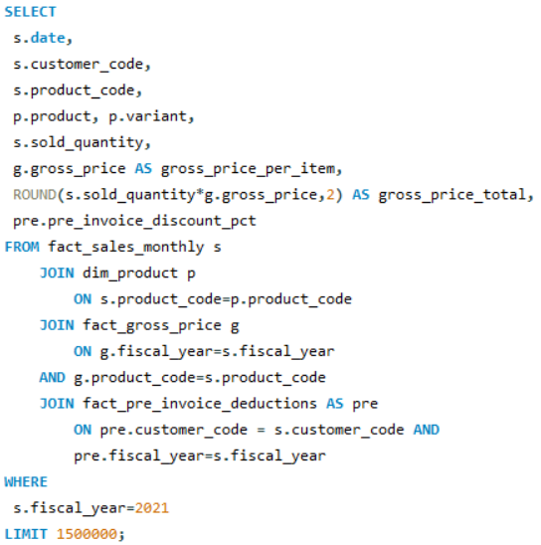
P&L report:
Retrieve pre invoice discount percent by joining two tables
OUTPUT

Slide 19
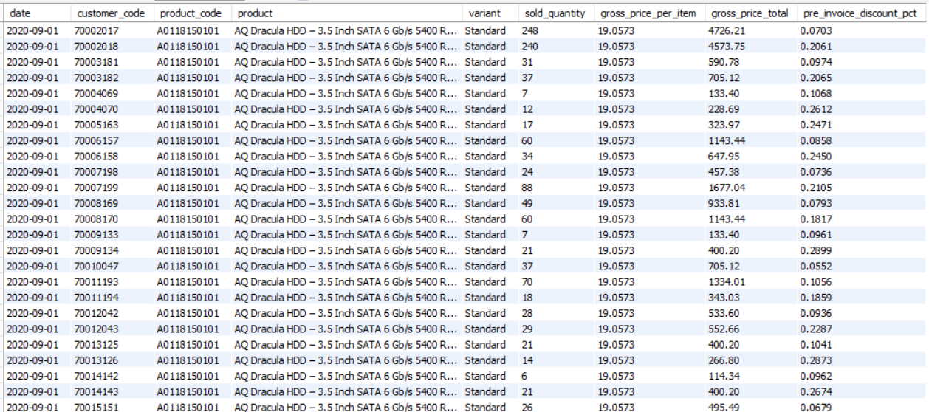

Slide 20
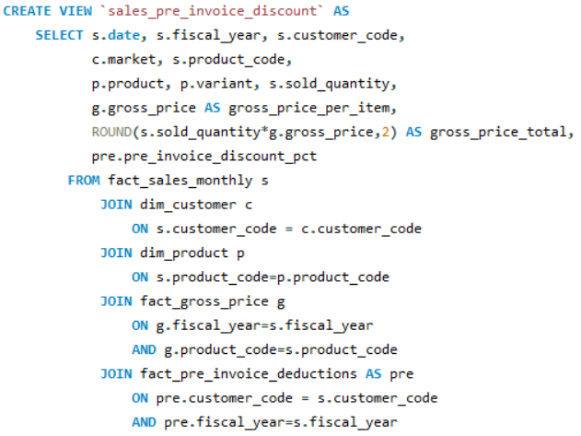
Create view “sales_pre_invoice_discount”.

Slide 21
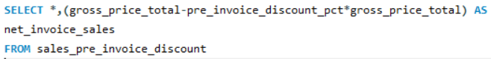
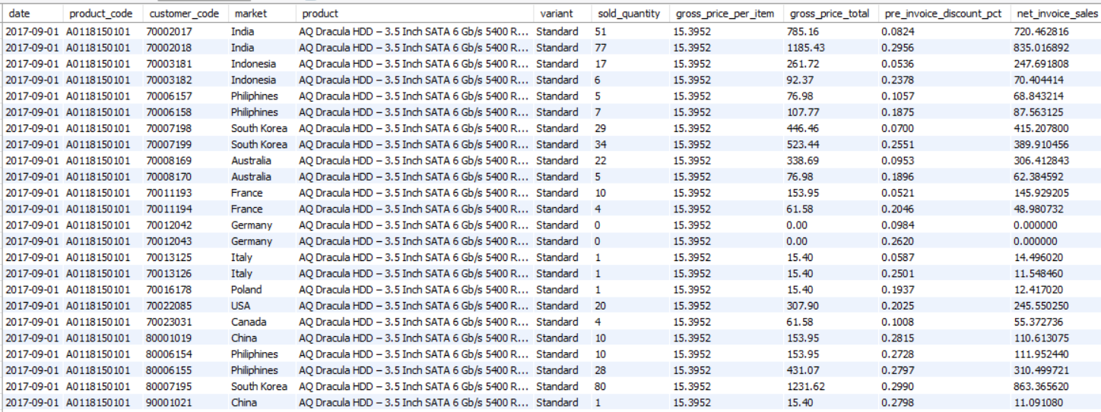
Using view sales_pre_invoice_discount generate the net_invoice_sales

Slide 22
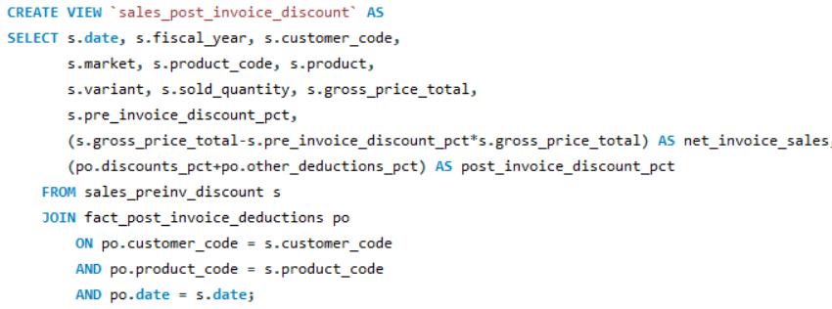
Create view “sales_post_invoice_discount”.

Slide 23
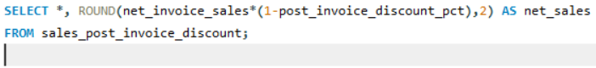
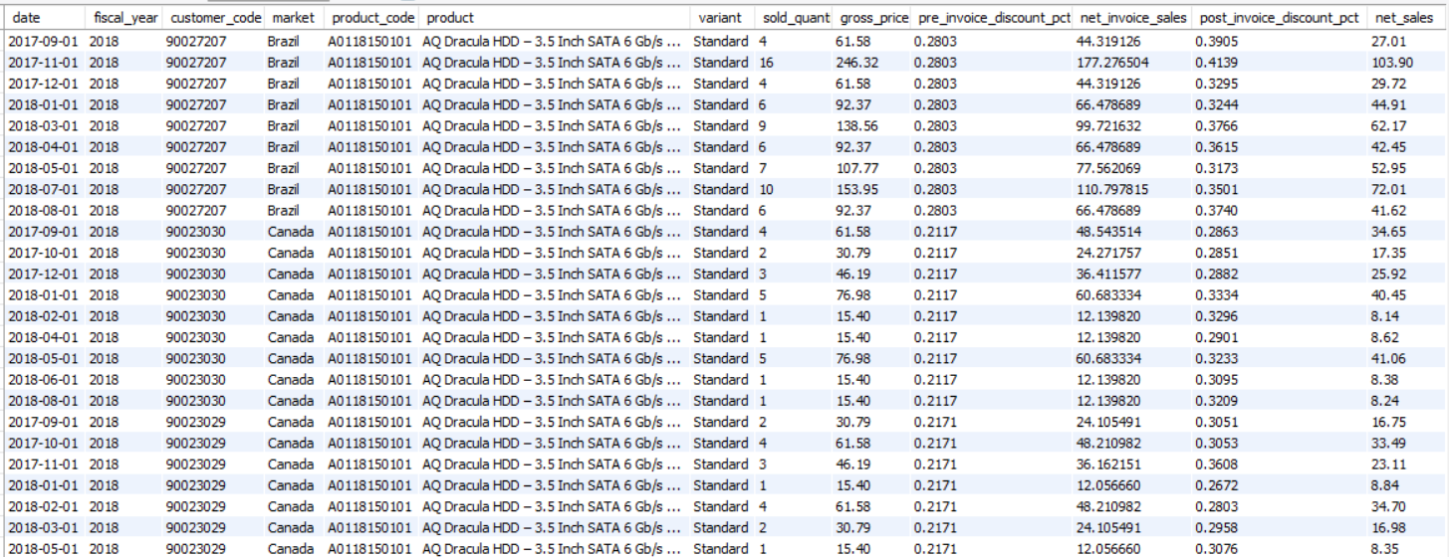
Using view sales_post_invoice_discount generate the Net sales

Slide 24
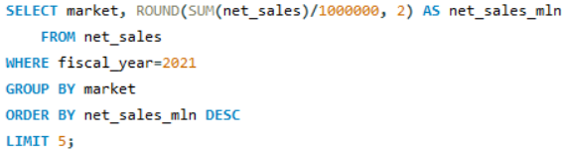
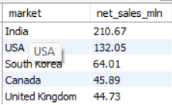
Retrieve Top 5 Markets by Net sales in Fiscal year 2021

Slide 25
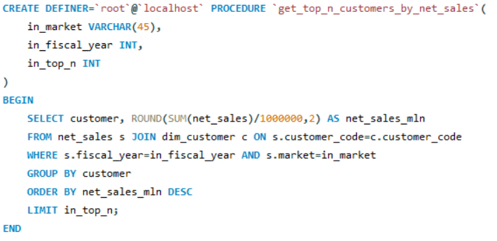
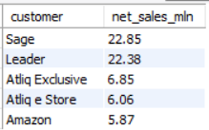
Create stored procedure to get Top n Customers by Net sales for fiscal year
Top 5 Customers in South korea

Slide 26
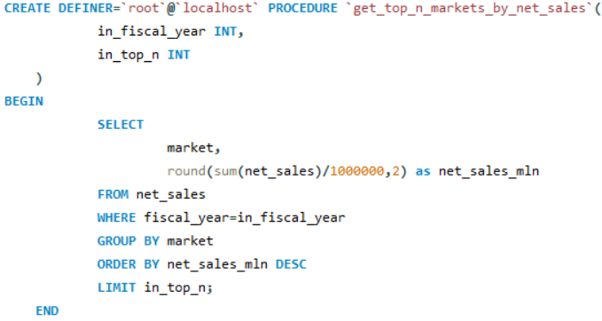
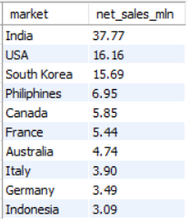
Create stored procedure to get Top n Markets by Net sales for fiscal year
Top 10 Markets in FY 2019

Slide 27
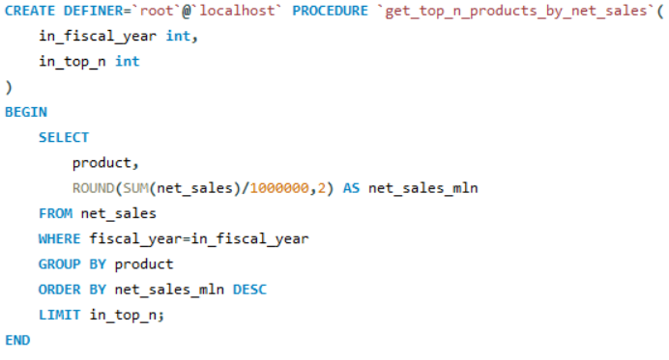
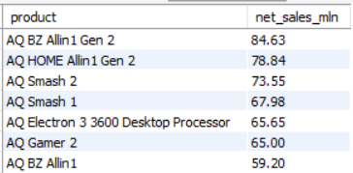
Create stored procedure to get Top n Products by Net sales
for fiscal year
Top 7 Products in FY 2022

Slide 28
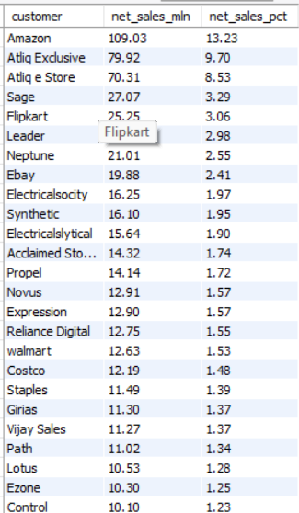
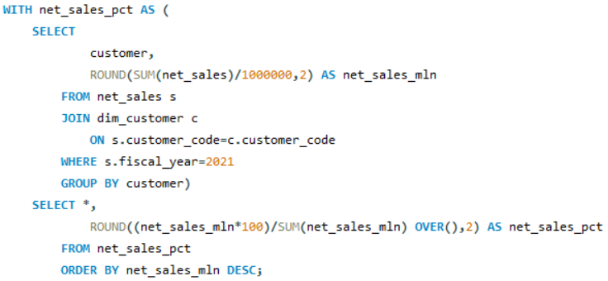
COMMON TABLE EXPRESSION (CTE’s)
Generate customer-wise Net sales % Distribution by creating CTE.

Slide 29
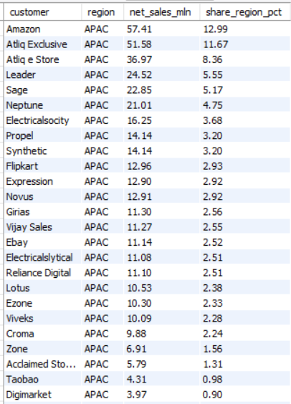
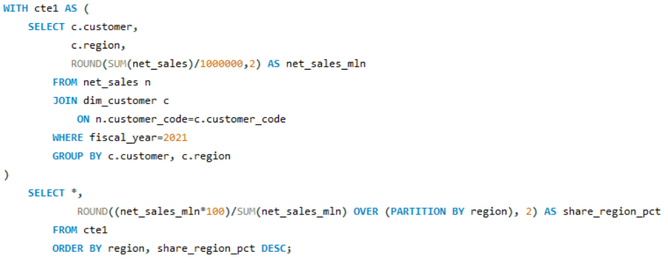
Generate customer-wise % share per Region by creating CTE.

Slide 30
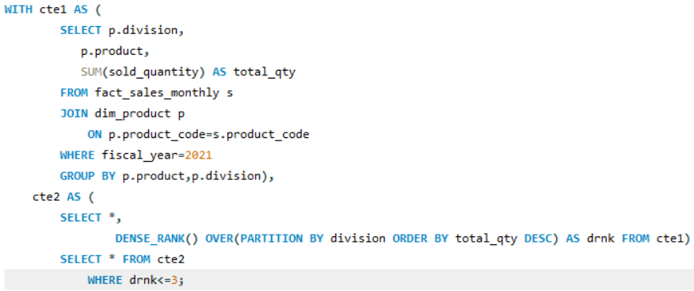
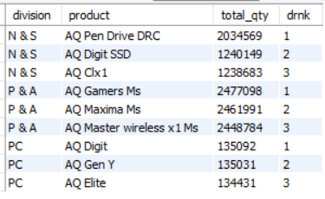
WINDOW FUNCTIONS
Rank the Products Division-wise based on sold quantity

Slide 31
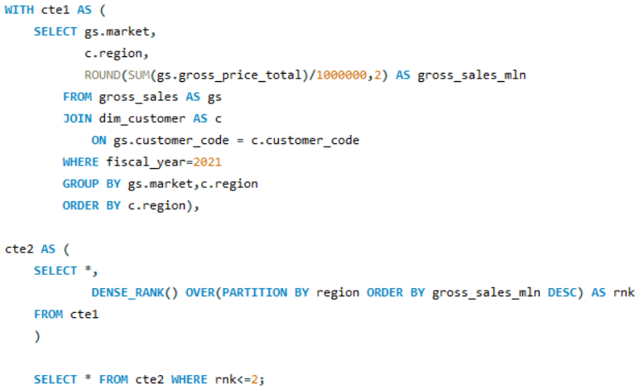

Rank the Markets Region-wise based on gross sales

Slide 32




Slide 33


Data Visualize the Insights using PowerBI

Slide 34
INSIGHTS
India leads in Gross sales, with a total sales of 1.4 Billion.
AQ Pen drive DRC has the highest quantity sold, reaching 2.03 Millions units.
Amazon has the highest net sales in fiscal year 2021 which is 109.3 million.
India earned Gold badge in 2021 having 5.3 Million quantity sold.

